Slide 1

Application: FoodPantry Type: Application Architecture View: Logical View Style: Layered Architecture Pattern
Users
Delivery Channels
Core Business Processes
Data And Information
Technology Enablers
Donate Food
User Information
For Database
Donors
Deliver Food
Location
Connection for Database (MySQL)
Mobile App
Donate Money
Food Information
Couriers
Request Food
Donation Information
Location API (Google API)
Message
Contacts
User Interface (React, Ionic)
Receivers
Browser
Feedback
Feedback
Application Hosting Server (AWS Elastic)
Locate User
Money Donation
Github & Delivery Pipeline
Administrator
Contact User
Address

Slide 2
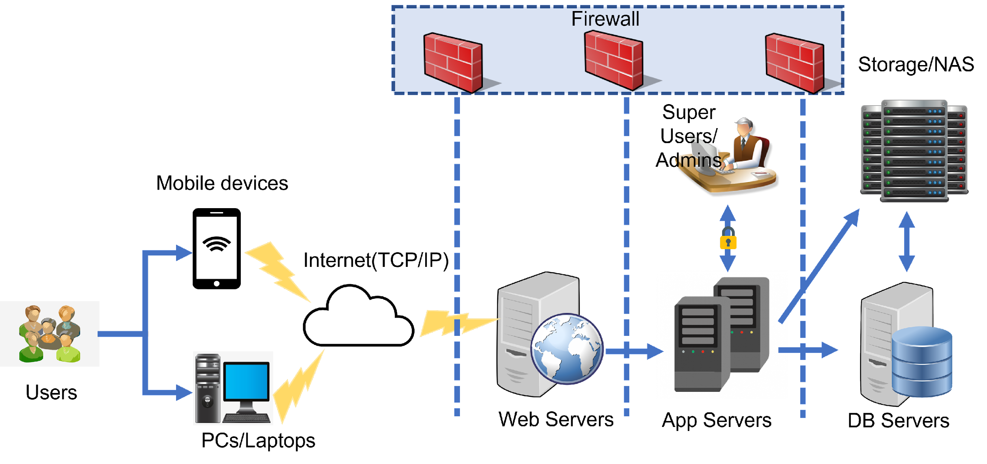
Application: FoodPantry Type: Application Architecture View: Process View Style: Client-Server Pattern

